Slide 1
Machine Learning
Machine Learning Introduction to Machine Learning by Kumar Anurupam is licensed under a Creative Commons Attribution-4.0 International License.
Clustering - Similarity Measure, K-means
CS 3104 Fall 2019
Lecture Slides by Kumar Anurupam

Slide 2
Learning Objective
After the completion of today’s lesson students will be able to:
Explain the similarity and dissimilarity measure in Cluster Analysis.
Describe the concept of k-means clustering.

Slide 3
Measure the Quality of Clustering
Dissimilarity/Similarity metric: Similarity is expressed in terms of a distance function, typically metric: d(i, j)
There is a separate “quality” function that measures the “goodness” of a cluster.
The definitions of distance functions are usually very different for interval-scaled, Boolean, categorical, ordinal, ratio, and vector variables.

Slide 4
Types of data in Cluster analysis
Interval-scaled variables and ratio variables
Binary variables
Nominal, ordinal
Variables of mixed types

Slide 5
Sample dataset
 | Interval scaled Ratio |  | Ratio | Binary |  | Ordinal |  | Nominal
 | body Temp (oF) | Weight(Kg) | height(Feet) | Gender | Pass/fail | Grade | DIVISION | Faireness | eye color
 | 98 | 55 | 5.5 | F | P | A | 1 | Fair | RED
 | 97.5 | 60 | 6 | M | F | Ex | 2 | WHITE | BLUE
 | 97.8 | 65 | 6.1 | M | p | B | 3 | FAIR | BROWN
 | 98.1 | 56 | 5.2 | F | p | A | 2 | BLACK | BLUE
 | 98 | 54 | 5 | F | F | C | 2 | WHITE | BROWN
 | 98.5 | 62 | 5.6 | M | F | D | 1 | FAIR | BLACK
 | 99 | 50 | 4.8 | F | F | R | 1 | FAIR | BLACK
 | 98.5 | 65 | 5.4 | F | P | R | 1 | FAIR | RED
 | 97.8 | 70 | 5.8 | M | P | C | 3 | WHITE | BLUE

Slide 6

Similarity Between Objects of Interval-scaled or Ratio-scaled variables
Distances are normally used to measure the similarity or dissimilarity between two data objects
Some popular ones include: Minkowski distance:
where i = (x_{i1}, x_{i2}, …, x_{ip}) and j = (x_{j1}, x_{j2}, …, x_{jp}) are two p-dimensional data objects, and q is a positive integer
If q = 1, d is Manhattan distance
If q = 2, d is Euclidean distance.

Slide 7
Dissimilarity for Binary Variables
Object j
A contingency table for binary data
Distance measure for symmetric binary variables:
Distance measure for asymmetric binary variables:
Jaccard coefficient (similarity measure for asymmetric binary variables):
Object i

Slide 8
Nominal Variables
A generalization of the binary variable in that it can take more than 2 states, e.g., red, yellow, blue, green
Method 1: Simple matching
m: # of matches, p: total # of variables
Method 2: Use a large number of binary variables
Creating a new binary variable for each of the M nominal states
Using similarity measures of binary variables

Slide 9
Ordinal Variables
An ordinal variable can be discrete or continuous
Order is important, e.g., rank
Can be treated like interval-scaled
replace x_{if} by their rank
map the range of each variable onto [0, 1] by replacing i-th object in the f-th variable by
compute the dissimilarity using methods for interval-scaled variables

Slide 10

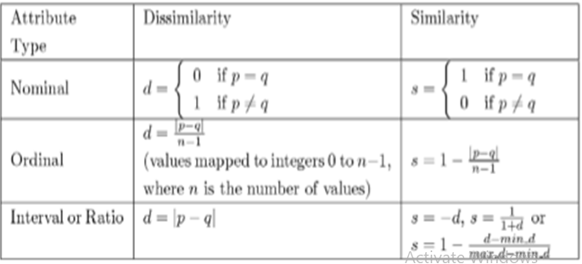
Variables of Mixed Types
A database may contain all the six types of variables
One may use a weighted formula to combine their effects
Compute δ
δ_{ij}^{(f)} = 0 , if x_{if} = x_{jf} and f is binary or nominal
1 otherwise

Slide 11
Major Clustering Approaches (I)
Partitioning approach:
Construct various partitions and then evaluate them by some criterion, e.g., minimizing the sum of square errors
Typical methods: k-means, k-medoids, CLARANS
Hierarchical approach:
Create a hierarchical decomposition of the set of data (or objects) using some criterion
Typical methods: Diana, Agnes, BIRCH, ROCK, CAMELEON
Density-based approach:
Based on connectivity and density functions
Typical methods: DBSACN, OPTICS, DenClue

Slide 12
Major Clustering Approaches (II)
Grid-based approach:
based on a multiple-level granularity structure
Typical methods: STING, WaveCluster, CLIQUE
Model-based:
A model is hypothesized for each of the clusters and tries to find the best fit of that model to each other
Typical methods: EM, SOM, COBWEB
Frequent pattern-based:
Based on the analysis of frequent patterns
Typical methods: pCluster
User-guided or constraint-based:
Clustering by considering user-specified or application-specific constraints
Typical methods: COD (obstacles), constrained clustering

Slide 13
Typical Distance between Clusters
Single link: smallest distance between an element in one cluster and an element in the other, i.e., dis(K_{i}, K_{j}) = min(t_{ip}, t_{jq})
Complete link: largest distance between an element in one cluster and an element in the other, i.e., dis(K_{i}, K_{j}) = max(t_{ip}, t_{jq})
Average: avg distance between an element in one cluster and an element in the other, i.e., dis(K_{i}, K_{j}) = avg(t_{ip}, t_{jq})
Centroid: distance between the centroids of two clusters, i.e., dis(K_{i}, K_{j}) = dis(C_{i}, C_{j})
Medoid: distance between the medoids of two clusters, i.e., dis(K_{i}, K_{j}) = dis(M_{i}, M_{j})
Medoid: one chosen, centrally located object in the cluster

Slide 14
K-means introduction
It is a typical clustering analysis approach via iteratively partitioning training data set to learn a partition of the given data space.
Based on learning a partition on a data set to produce several non-empty clusters (usually, the number of clusters given in advance)
It is similar to the expectation-maximization algorithm for mixtures of Gaussians in that they both attempt to find the centers of natural clusters in the data.
In principle, optimal partition achieved via minimizing the sum of squared distance to its “representative object” in each cluster:
Where,
k = number of clusters
C_{i} = ith cluster
c_{i} = Centroid/Medoid of i^{th} cluster
p = Points in cluster i^{th} cluster

Slide 15
K – means algorithm
Decide on a value for k.
Initialize the k cluster centers (randomly, if necessary).
Decide the class memberships of the N objects by assigning them to the nearest cluster center.
Re-estimate the k cluster centers, by assuming the memberships found above are correct.
If none of the N objects changed membership in the last iteration, exit. Otherwise goto 3.

Slide 16
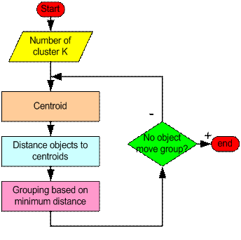
K- means algorithm Flowchart

Slide 17
Strengths and Weakness of k-means
Strengths
Relatively efficient: O(tkn), where n is # objects, k is # clusters, and t is # iterations. Normally, k, t << n.
Often terminates at a local optimum. The global optimum may be found using techniques such as simulated annealing and genetic algorithms
Weaknesses
Applicable only when mean is defined (what about categorical data?)
Need to specify k, the number of clusters, in advance
Trouble with noisy data and outliers
Not suitable to discover clusters with non-convex shapes

Slide 18
Thank you

